Slide 1



The Law of Demand
Important Factors that Change Demand
DEMAND CURVE SHIFT

Slide 2

How is the price for a good or service determined?
A Combination of Supply and Demand
The Supply = How much is made available by the company (producer)
The Demand = How much is demanded by the consumer

Slide 3

What is DEMAND?
Demand = the amount of a good or service that consumers are willing to buy.

Slide 4

What is the Law of Demand?
The law of demand = says that consumers are willing to buy (demand) more of a good or service when prices go down.
= or consumers will buy (demand) less when prices increase.
Way is this True?: When a good becomes cheaper, people see it as a deal and will want or demand more of it.
The opposite is true when the price of something goes up; people see it as expensive and are less likely to buy it.
.

Slide 5
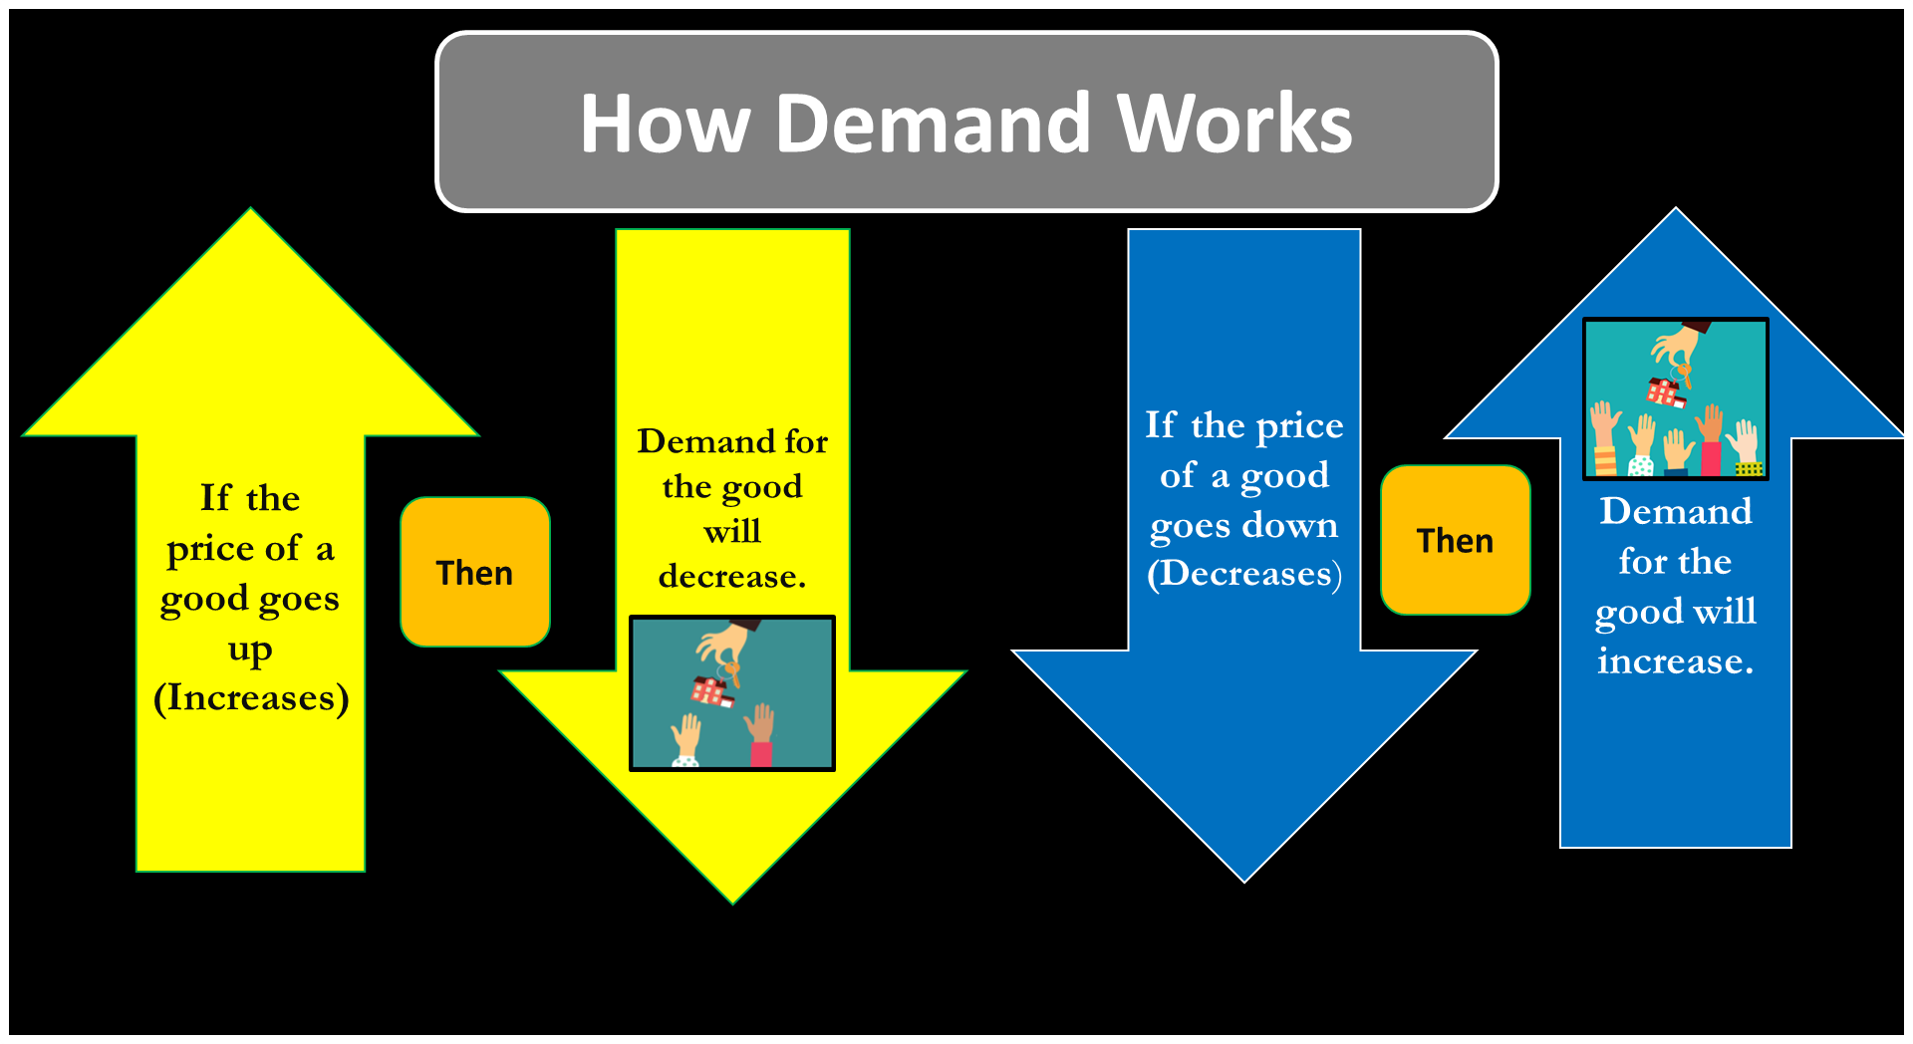

Slide 6

What does Demand Look Like on a Chart?
a. Demand can be shown on Demand Schedule Chart.
Demand Schedule for Ipads
Price for One Ipad | Demand for Ipads
If the price of an Ipad is $1000 | 5 people would demand it
$800 | 10
$600 | 15
$400 | 20

Slide 7
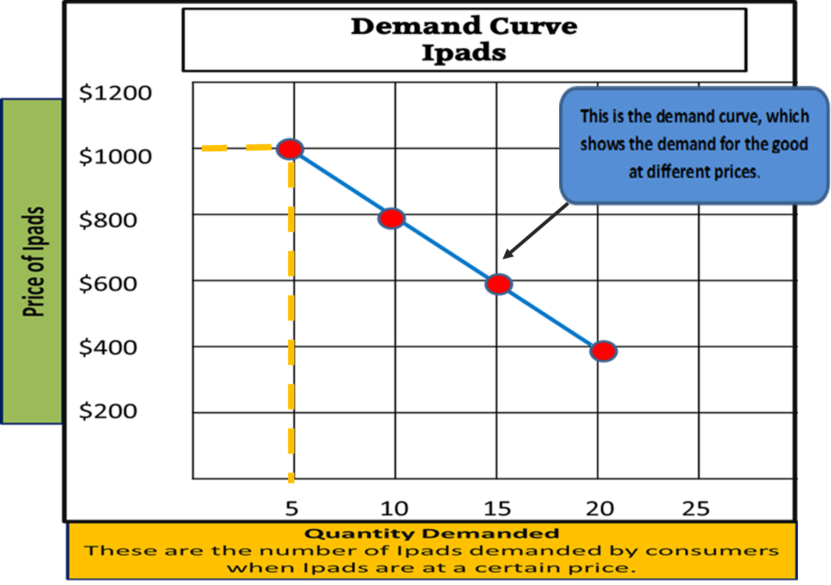
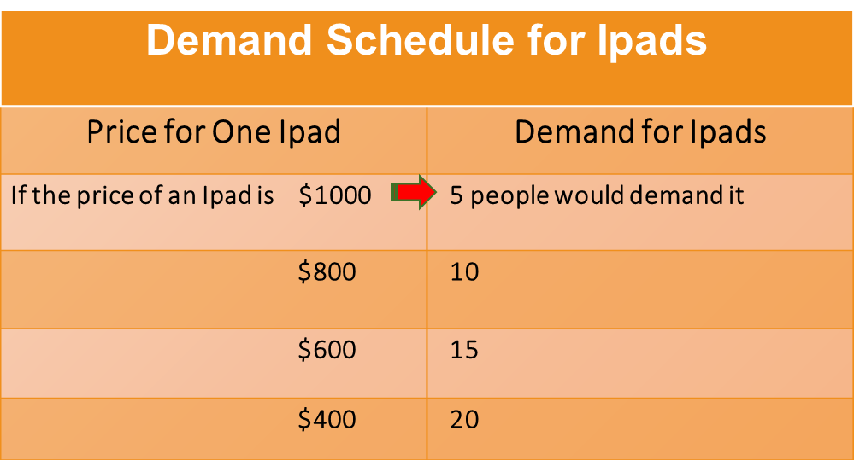
How can demand be shown on a graph?

Slide 8

What are five factors that can change demand?
A. Besides price, others things can change the demand for goods.
C omplementary Goods
T astes
I ncome
P opulation
S ubstitute Goods

Slide 9

How does INCOME change demand?
The more money people make, the more goods they are able to buy.
A. Higher incomes lead to a increase demand.
B. Lower incomes cause a decrease in demand.

Slide 10

How does consumers’ taste change demand?
A. If a good is popular or considered fashionable then the demand for the good will increase.
B. If a good is unpopular or disliked there is a decrease in the demand for it.

Slide 11

How does POPULATION change demand?
An increase in the number of people, means more people are able to buy a good.
a. Increase in population = Increase in demand.
b. Decrease in population = Decrease in demand.

